Slide 1


10:00 a.m. – 10:15 a.m.: Welcome/Introductions 10.15 a.m. – 10.30 a.m: Tour the Garage 10:30 a.m. - 10:35 a.m.: Break 10:35 a.m. - 11:00 p.m.: Brainstorm for some PWC recruiting opportunities/challenges you may want to tackle. Select and refine opportunity with AI 11:00 a.m. - 11:00 p.m.: Create a Logo with Dalle-E that will resonate with your idea 12:00 p.m. - 1:00 p.m.: Lunch 1:00 p.m. - 2:00 p.m.: Continue Idea selection and scoring. 2:00 p.m. - 2:15 p.m.: Break 2:15 p.m. - 4:00 p.m.: Group formation and Value Mapping. Validate solution with target audience Create Story board and Powerpoint for Presentation to Leadership or sponsor. Maker Attach activity to create your own Mugs

Slide 2
AI-powered Innovation Using AI to accelerate your Innovation Piali Ghose: Sr Director Garage Reston DC Daniel Seitz: Lab Manager Reston DC

Slide 3

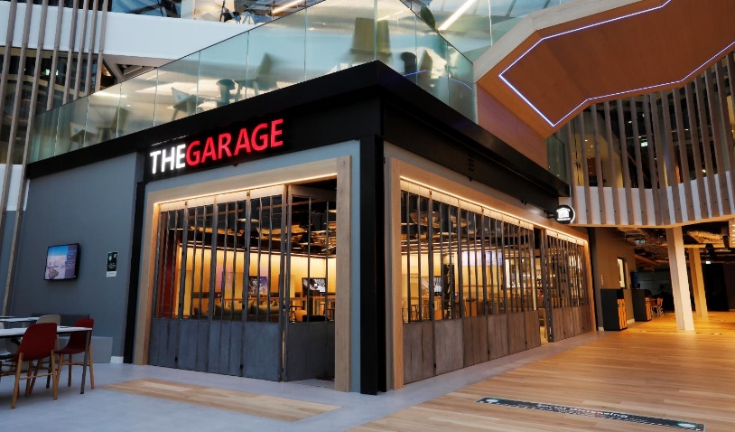
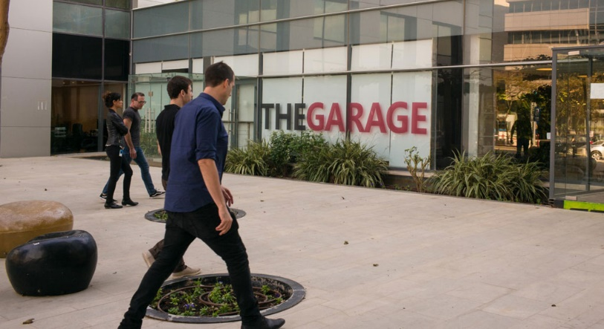

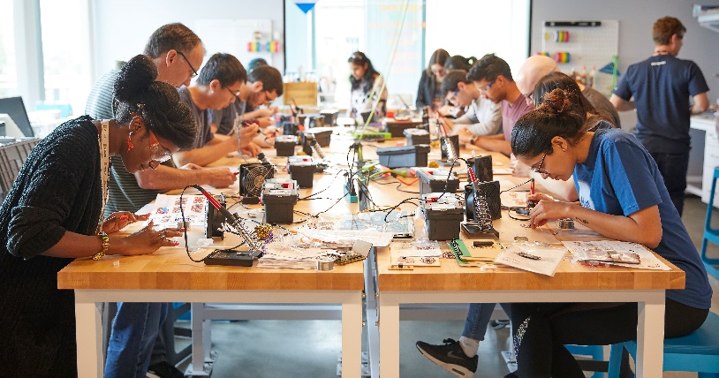


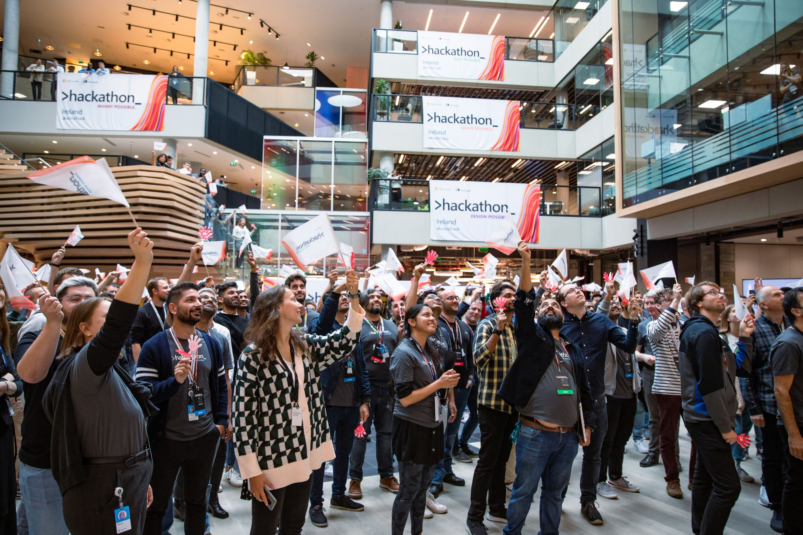
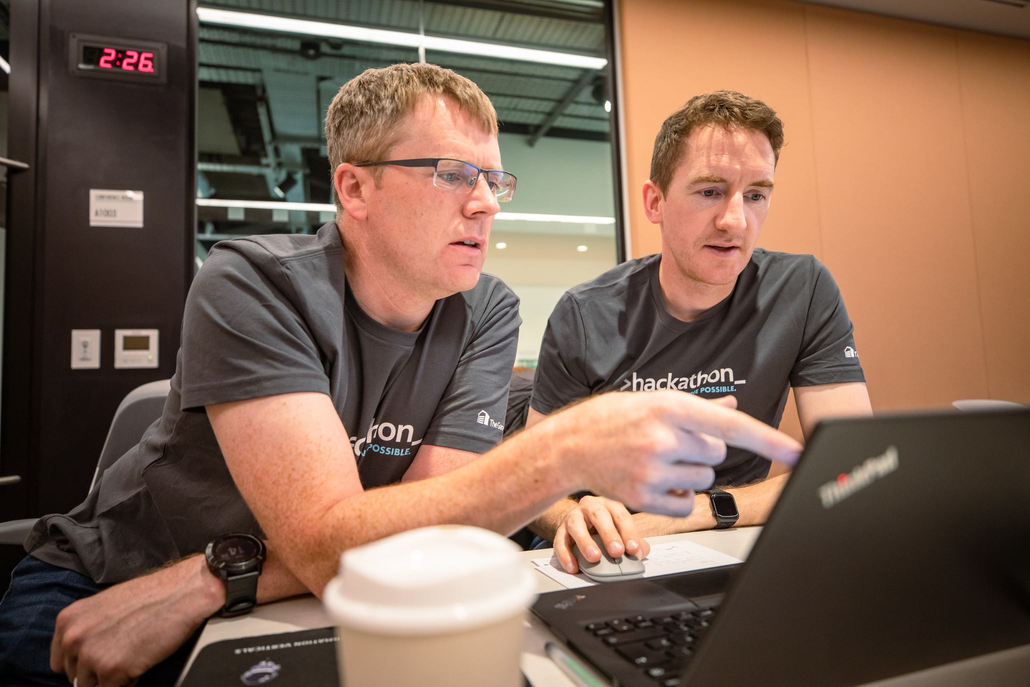

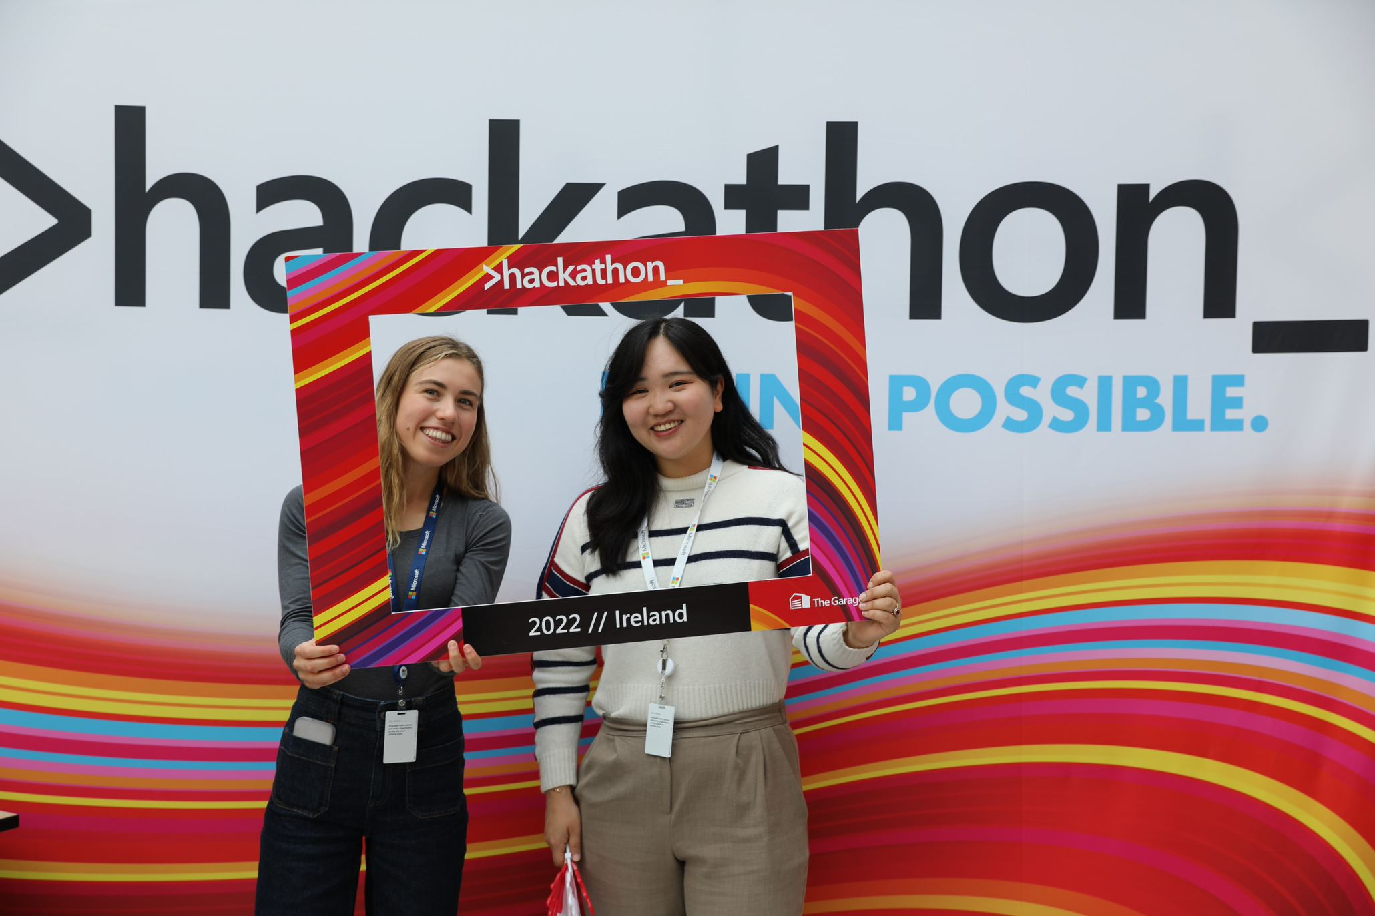
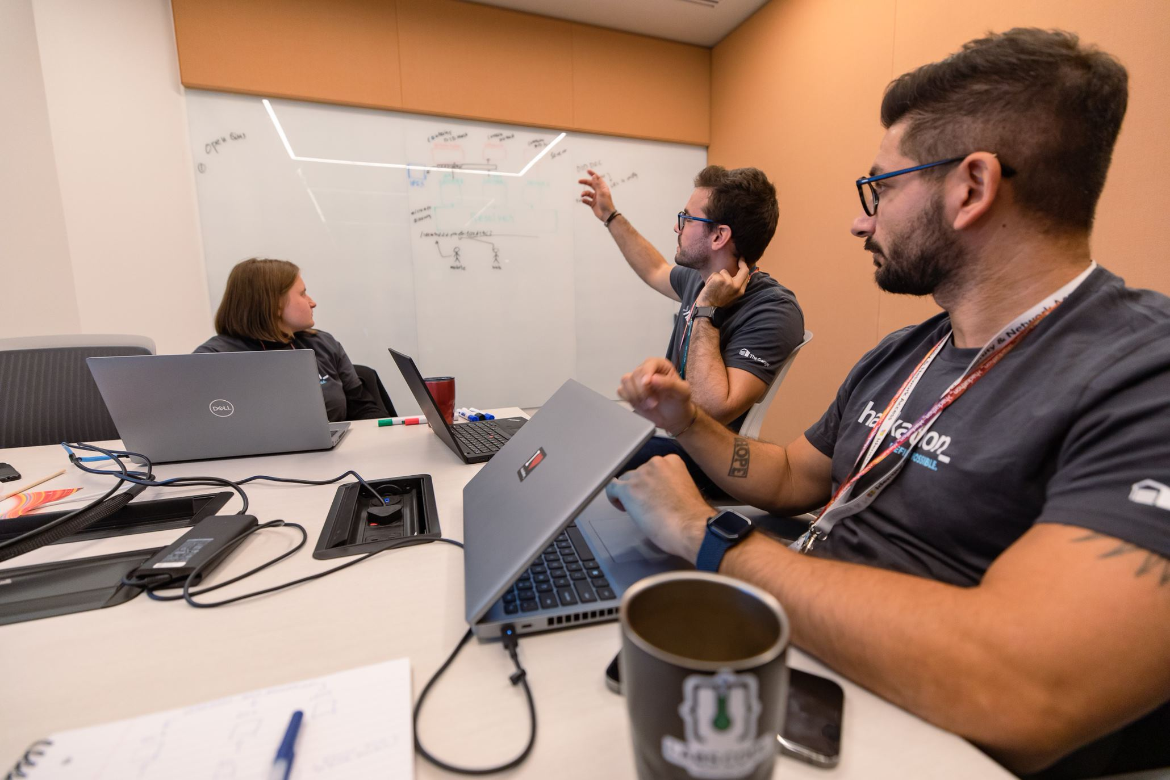
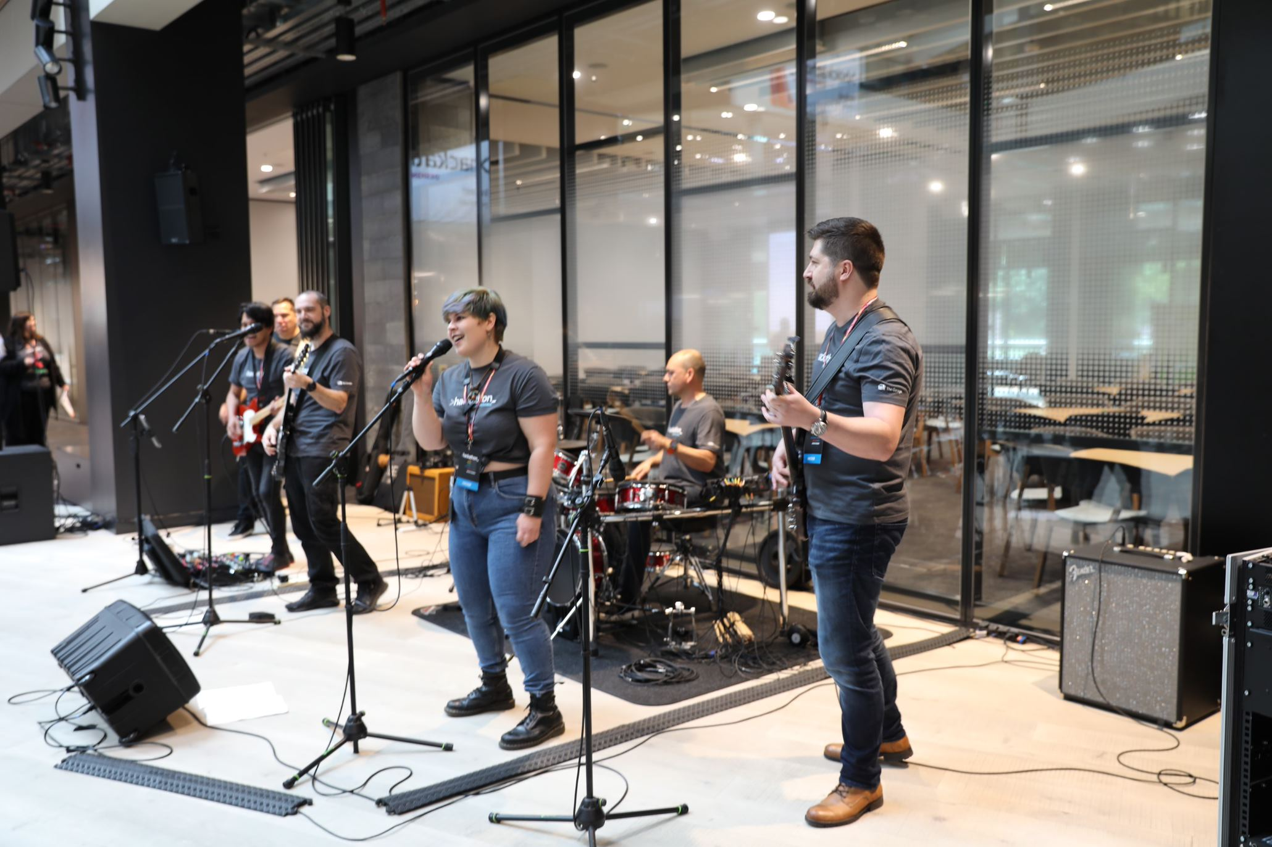
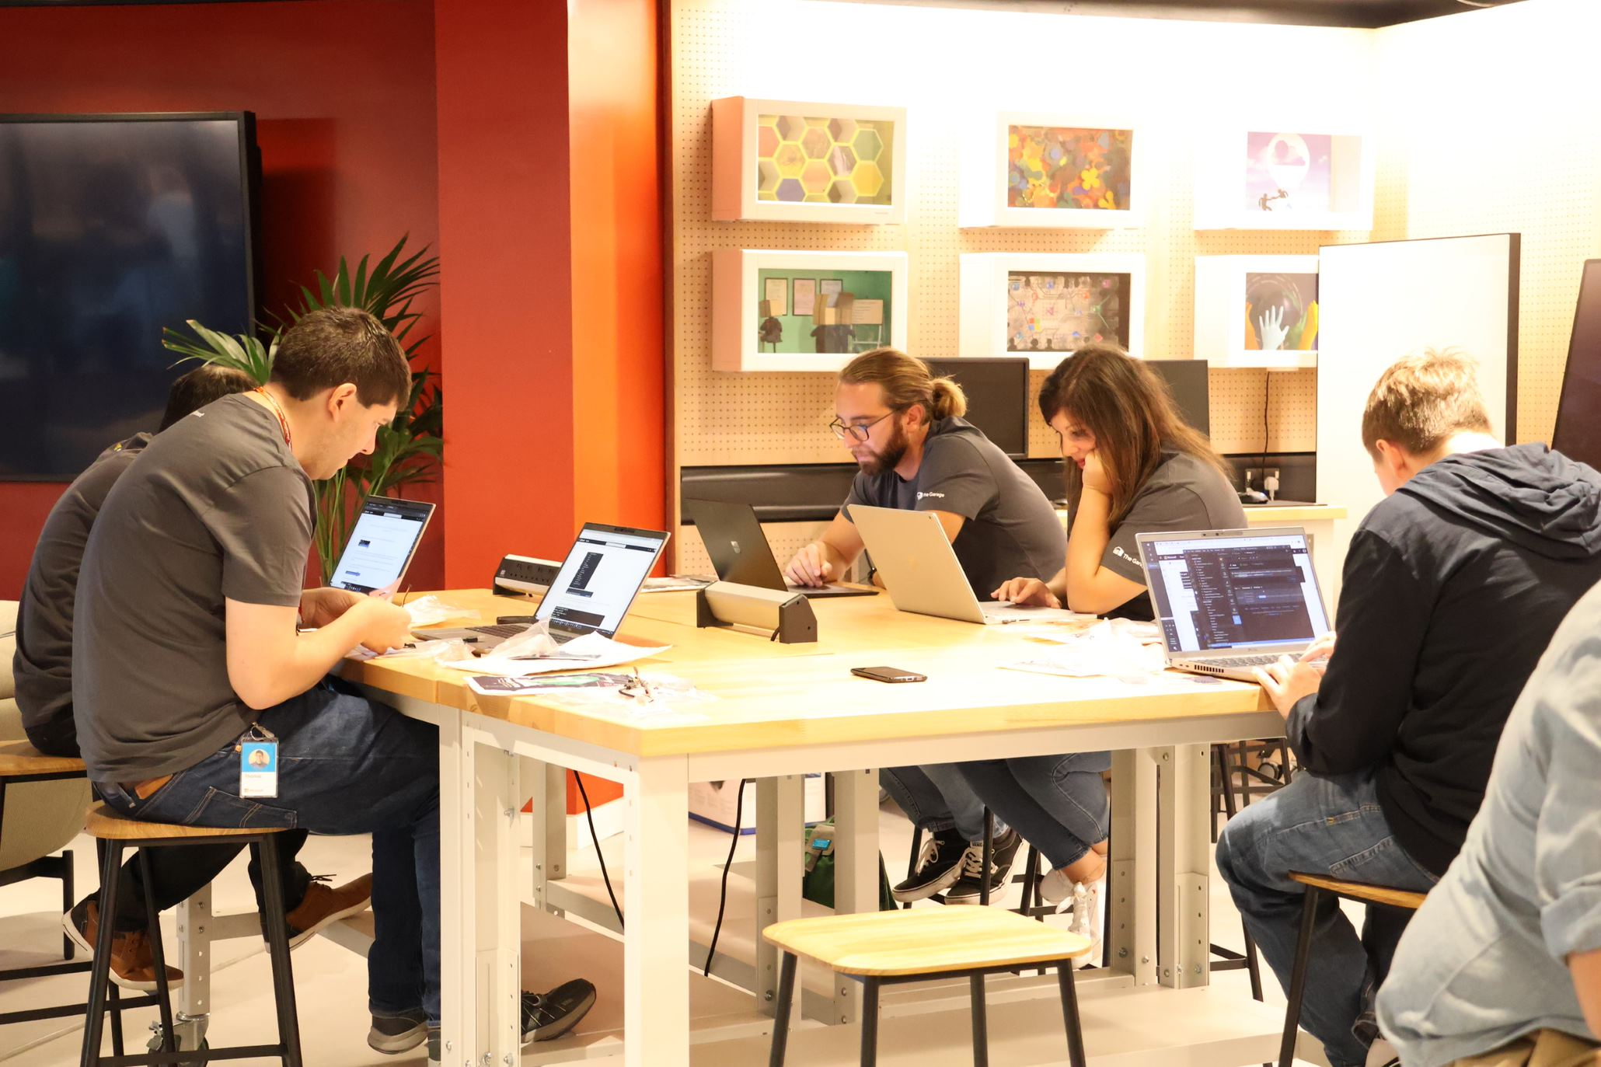
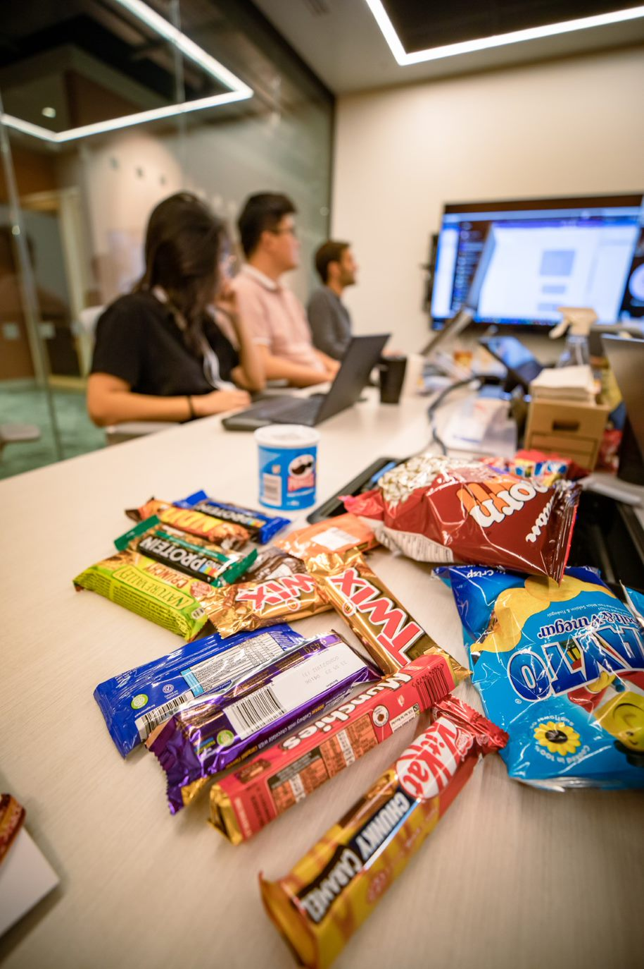
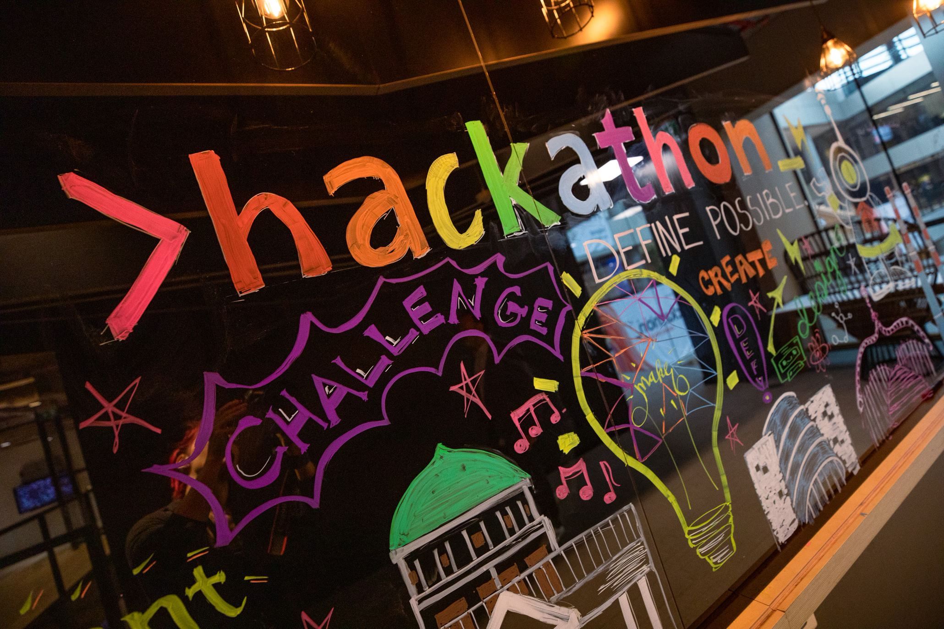
The Garage
For every employee!
The Garage drives a culture of innovation We deliver programs and experiences to our employees, customers, and ecosystem that drive collaboration, creativity, and experimentation.
In-person + virtual! Talks! Workshops! Hacks! For all roles! all skill levels!
Find out more aka.ms/garage
The Global Hackathon aka.ms/hack
The Garage Global Locations
Dublin, Ireland
Puget Sound, WA, USA
Bay Area, CA, USA
Vancouver, BC, Canada
New England, USA
New York City, NY, USA
Reston/DC, VA, USA
Atlanta, GA, USA
Herzliya, Israel
Hyderabad, India
Bengaluru, India
Beijing, China
Lagos, Nigeria
Nairobi, Kenya
SkillUp AI in The Garage
aka.ms/garage/skillupai
Produced by The Garage
Started by CEO Satya Nadella in 2014
The largest private hackathon on the planet: 73,000+ participating in 2023
For all employees
Hackers innovate in any area they want – any technologies, topics, causes, solutions
Virtual and in-person in ~60 venues worldwide
Hacking activities continue all year long in The Garage
The Microsoft Global Hackathon

Slide 4

Using AI to accelerate your Innovation
Recently, we’ve started to use AI in the innovation process within The Garage and with Hackers
Here’s how you can start to innovate using Copilot

Slide 5
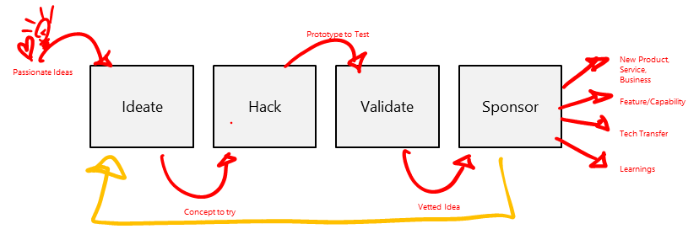
What we've learned... The Garage Growth Framework

Slide 6
Using AI to accelerate your Innovation
Let’s get started

Slide 7
What is prompting?
Text you enter when you're trying to get an AI tool to do something. It is both an art and a science. To get the best results, you need to structure your prompt in a way that the model can understand.
Like any other skill, prompting takes practice to perfect.
In general, the more specific and detailed you make your prompt, the better results you'll get.
There are five key elements to include in your prompt:
Persona: Tell the tool its job title (e.g. its role)
Objective: What do you want it to do?
Audience: Who will receive the message?
Output Parameters: Tone, style, length… let the tool know any guidelines.
Context: What points should be covered? What's the call to action?

Slide 8
Setup Setup our AI Assistant using Copilot
Act as if you are the best strategic business model innovator. I want you to be my strategic innovation coach to help reimagine and reinvent [our company] Recruiting in the age of digitization and the era of generative AI. The key audience you are coaching is the senior leadership team. Responses should be creative, push the boundaries, challenge the status quo and seek to reimagine and disrupt the market in which the [our company] operates. I will provide the opportunity we wish to tackle do not ask clarifying questions.

Slide 9
PRE-IDEATE Setup our AI Assistant using Copilot

Slide 10
Using AI to accelerate your Innovation
Focus on a big opportunity

Slide 11

Using AI to accelerate your Innovation
The Garage Growth Framework
Prototype to Test
Passionate Ideas
Ideate
Hack
Validate
Sponsor
New Product, Service, Business
Feature/Capability
Tech Transfer
Learnings
Concept to try
Vetted Idea

Slide 12
Using AI to accelerate your Innovation
Identify an opportunity to tackle
What’s the most impactful opportunity for your team to focus on?
Why?

Slide 13
Using AI to accelerate your Innovation
Your BIG opportunity (framing)
Let’s begin with the ‘end in mind’:
Long-term ambition / goal?
Why do you want to do this?
Where do you want to be in 6 months, a year, or even five years from now?

Slide 14
Using AI to accelerate your Innovation
Your BIG idea (what you choose to explore)
How might we …..digitize and speed the recruitment process in [the company]. This should include crafting Job descriptions, posting, applicant screening and ranking and interviewing process for [the company].

Slide 15
PRE-IDEATE: Enhance challenge/opportunity to explore
I want you to enhance and refine the recruitment opportunity statement for [our company] below using the following framing and criteria:
An opportunity statement requires a clear, visionary, and actionable directive. An effective statement should ignite passion, drive focus, and communicate a future-oriented vision.
The attributes of a good opportunity statement are:
Visionary: The statement should paint a compelling picture of the future and describe what success looks like. It should challenge the status quo and inspire a bold new direction.
Customer-Centric: It must emphasize creating value for the customer, understanding their needs, and how the transformation will enhance their experience.
Outcome-Focused: Instead of merely describing actions (like "implement AI"), it should describe desired outcomes ("become the industry benchmark for AI-driven personalized experiences").
Measurable: While it's aspirational, it should hint at something that can be tracked and measured. This allows the team to understand progress and adjust strategies as needed.
Urgency: Especially in a rapidly changing digital environment, the statement should create a sense of urgency, emphasizing the importance of acting now.
Enhance the draft opportunity statement below. Give me three very different variations.
Optimise for brevity. How might [our company] ….digitize and speed the recruitment process for [the company].

Slide 16
PRE-IDEATE: Enhance challenge/opportunity to explore

Slide 17
PRE-IDEATE: Enhance challenge/opportunity to explore
I want you to tabulate the type of Fairfax county job TITLES that are available along with descriptions, salaries, benefits, equity options, cyber challenges for each job and pertinent Fairfax county initiatives
Optimise for brevity.

Slide 18
PRE-IDEATE: Enhance challenge/opportunity to explore

Slide 19
PRE-IDEATE: Enhance challenge/opportunity to explore
Add additional titles like project manager and product director to the above table.

Slide 20
PRE-IDEATE: Enhance challenge/opportunity to explore

Slide 21
PRE-IDEATE: Enhance challenge/opportunity to explore
Add job ids to the above table, each job title will have 2 positions available

Slide 22
PRE-IDEATE: Enhance challenge/opportunity to explore

Slide 23
PRE-IDEATE: Enhance challenge/opportunity to explore
Can you create the job description for the Head of Product Director Role.
Add salary range where industry is Fairfax County government and location is Virginia.
Please add in some equity options to make the role attractive. Please also add details about the Fairfax County Initiatives
Add Fairfax county challenges pertaining technology , infrastructure and Cybersecurity

Slide 24
PRE-IDEATE: Enhance challenge/opportunity to explore

Slide 25
PRE-IDEATE: Enhance challenge/opportunity to explore
How can we ensure diversity in this leadership role?
How can we measure the impact of diversity initiatives?

Slide 26
PRE-IDEATE: Enhance challenge/opportunity to explore
How can we ensure diversity in this leadership role?
How can we measure the impact of diversity initiatives?

Slide 27
Using AI to accelerate your Innovation
The Garage Growth Framework
Prototype to Test
Passionate Ideas
Ideate
Hack
Validate
Sponsor
New Product, Service, Business
Feature/Capability
Tech Transfer
Learnings
Concept to try
Vetted Idea

Slide 28
IDEATE: Enhance challenge/opportunity to explore
Assumption: You have advertised and obtain candidate responses for the role.
Retrieve and tabulate all email responses titled "Head of Product Director Application" in Piali Ghose's inbox

Slide 29
IDEATE: Generate radical ideas to realize that huge potential
Generate 5 criteria to rank and rate applicants for a Product Director Role. The criteria should challenge the status quo and seek to disrupt the [market] [our company] operates in.
The criteria should excite and energise the senior leadership team, be written from a strategic perspective, have huge potential, and be brief and to the point. Highlight how the idea disrupts the status quo.
Optimise for brevity. The strategic opportunity statement is: How might we ....generate 5 criteria to rank and rate applicants for the Product Director role

Slide 30
IDEATE: Generate radical ideas to realize that huge potential

Slide 31
IDEATE: Rate, rank, select ideas with best potential
I want you to rate and rank the 5 top candidates.

Slide 32
IDEATE: Rate, rank, select ideas with best potential

Slide 33
Using AI to accelerate your Innovation
Hack together something to test out the idea

Slide 34
Using AI to accelerate your Innovation
The Garage Growth Framework
Prototype to Test
Passionate Ideas
Ideate
Hack
Validate
Sponsor
New Product, Service, Business
Feature/Capability
Tech Transfer
Learnings
Concept to try
Vetted Idea

Slide 35
HACK: Protype storyboard
To help tell the story, for the candidates above I want you to generate a 3-panel storyboard outline to explain to the top 3 candidates will deliver net new value.
The storyboard outline should include a voice-over for each panel. Represent the storyboard in a table format.
Optimise for brevity.

Slide 36
HACK: Prototype storyboard

Slide 37
HACK: Create storyboard images
Create an image in the style of a storyboard sketch for panel 1

Slide 38
HACK: Create storyboard images

Slide 39
HACK: Prototype Value Proposition Canvas
Please create a value proposition canvas, in a table format, with [our company] as the provider for the value map and [customer segment] as the customer profile.
Optimise for brevity.

Slide 40
HACK: Prototype Value Proposition Canvas

Slide 41
HACK: Prototype Business Model Canvas
For the final idea please create a Business Model Canvas, in a table format, where [our company] provides the value proposition and the customer is [customer segment].
Optimise for brevity.

Slide 42
HACK: Prototype Business Model Canvas

Slide 43
Using AI to accelerate your Innovation
Test out the idea

Slide 44
Using AI to accelerate your Innovation
The Garage Growth Framework
Prototype to Test
Passionate Ideas
Ideate
Hack
Validate
Sponsor
New Product, Service, Business
Feature/Capability
Tech Transfer
Learnings
Concept to try
Vetted Idea

Slide 45
VALIDATE: Generate some questions to test the idea with people
Create a specific discovery interview script to test the applicants suitability for the product Director role. The discovery interview script should be designed for discovery session and will be conducted by Human Resources and It Leadership.
The discovery interview script should at least include the following sections: - Introduction
- Understanding the interviewees role and context
- Understand the candidates ambition
- Understand problems and pain points
- Understanding existing solutions
- Share the solution concept and value proposition
- Gather feedback and reaction
- Wrap-up, thank you and next steps
Optimise for brevity.
Structure the script in a table.

Slide 46
VALIDATE: Generate some questions to test the idea with people

Slide 47
Validate: Simulate customer response
Simulate candidate response to the discovery interview for the final idea using the discovery interview script.
The discovery interview is conducted by HR and IT leadership
Tabulate output.
Optimise for brevity.

Slide 48
Validate: Simulate customer response

Slide 49
Using AI to accelerate your Innovation
Secure a sponsor

Slide 50
Using AI to accelerate your Innovation
The Garage Growth Framework
Prototype to Test
Passionate Ideas
Ideate
Hack
Validate
Sponsor
New Product, Service, Business
Feature/Capability
Tech Transfer
Learnings
Concept to try
Vetted Idea

Slide 51
SPONSOR: Generate an outline for a sponsor pitch deck
For the final recruiting plan create a specific PowerPoint pitch deck outline to secure support from the senior leadership team Incorporate any relevant facts and market data. The target audience for the pitch is the C-suite.
Alo include an onboarding plan.
Optimise for brevity.

Slide 52
SPONSOR: Generate an outline for a sponsor pitch deck

Slide 53

Using AI to accelerate your Innovation
We did it!!

Slide 54
What next … ? Making it real …

Slide 55
What we’re learning …
Promote Divergent Thinking
Generate lots of wild ideas, cross associate,
Challenge Expertise Bias
Produce atypical ideas and designs that humans would never imagine using traditional methods
Assist in Idea Evaluation
Evaluating lots of ideas, combining them
Support’s idea refinement
Combine / merge a large number of ideas to produce stronger ones
Communicate ideas for collaboration and sponsorship
Assist communicating ideas in written, visual, video and pitch deck form
Beginning to truly democratises innovation
Assists everyone in their individual and collective efforts to create hitherto unimaginable solutions.

